Slide 1

Introduction to web application
Firewall

Slide 2
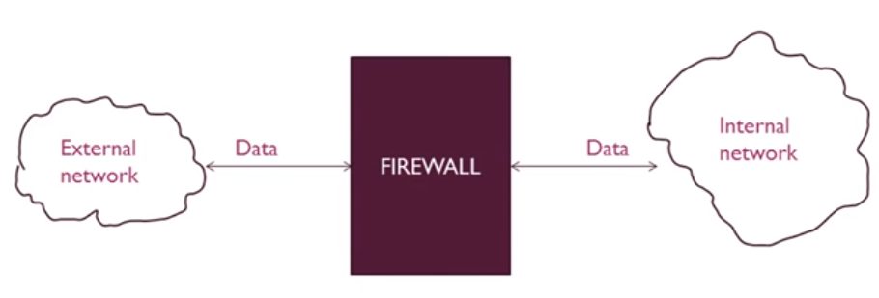
Firewalls
A network device.
Hardware and / or software.
All data pass through firewall.
After examining the data, firewall either block or pass the data.

Slide 3
Evolution of web
BEFORE
TODAY
Companies used websites to
provide information
Generally a one-way conversation
Content consisted mostly of html
and images
Users had a finite set of browsers,
system and operating systems
Websites used interactively
between companies and customers
Content includes lots of scripting,
applications, two way transfer of
files and data, and streaming media
Users access from thousands of
device types, OS, and browsers
Notes:
https://www.youtube.com/watch?v=xXxYJB3B8WY

Slide 4
Evolution of waf
Reverse Proxy
Traditional website protection, good at caching, keeping a buffer between outside world and inside world
Web Application Reverse Proxy
In addition to reverse proxy, application aware, including benefits for streaming and video, comprehensive policy, and rewrite capabilities, user awareness and tracking, SSL aware and capable, Inbound protection and scanning of uploaded files
Web Application Firewall
Focused on protection around PCI, compliance, attacks on websites, firewall capabilities, IPS, IDS

Slide 5
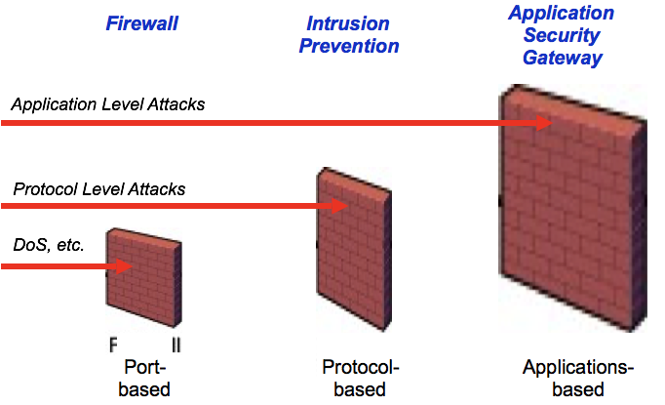
Difference to other security - solutions

Slide 6
Why do you need a waf?
Security
Application and Server OS vulnerabilities
Uploaded malicious content
OWASP Top 10
Sophisticated and targeted attacks
User Experience
Overburdened origin servers (offload SSL, webservices, cached content)
Complexity
Administrative overhead
Growing web infrastructures

Slide 7
Types of firewalls
Packet filtering router
Stateful Inspection Firewalls
Application-level gateway
Circuit-level gateway

Slide 8
Packet filtering router
It applies a set of rules to each incoming and outgoing IP packet which is present in list Acess control list.
The rules maybe based on source address, destination address, port numbers, protocols, Ip address etc.
If a rule is matched then it forwards or discard the packet.
The packet filter examines the header of each packet based on a specific set of rules, and on that basis, decides to prevent it from passing (called DROP) or allow it to pass (called ACCEPT).
It is Simple, but less secure.
Internet
Packet Filtering
router
Private Network

Slide 9
Stateful Inspection Firewalls
Stateful inspection is also known as dynamic packet filtering.
It is a firewall technology that monitors the state of active connections and uses this information to determine which network packets to allow through the firewall.
Stateful inspection has largely replaced an older technology, static packet filtering. In static packet filtering, only the headers of packets are checked -- which means that an attacker can sometimes get information through the firewall simply by indicating "reply" in the header. Stateful inspection, on the other hand, analyzes packets down to the application layer.
By recording information such as IP addresses and port numbers, a dynamic packet filter can implement a much tighter security posture than a static packet filter can.

Slide 10
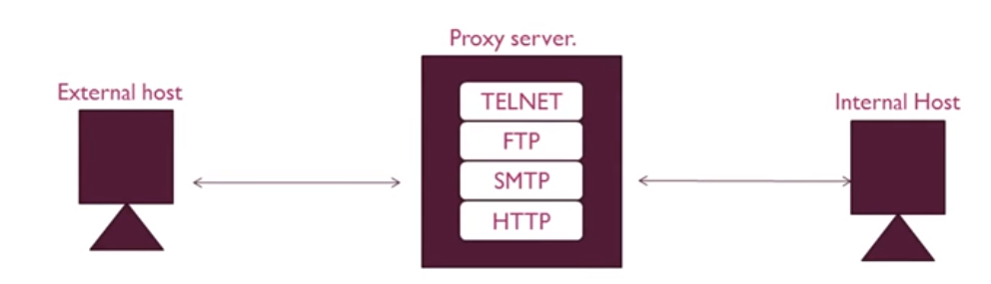
Application-level gateway
Also called proxy server.
Contacts user using TCP/IP application.
More secure than packet filtering.
Processing overhead

Slide 11
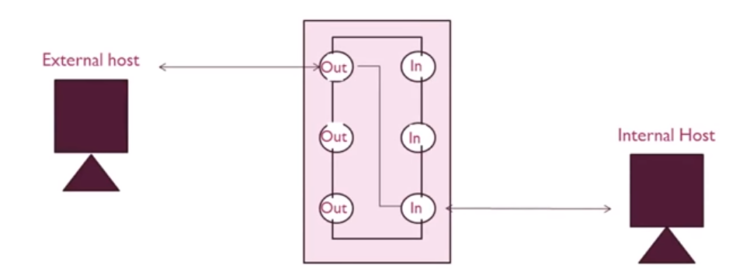
Circuit-level gateway
Does not permit an end-to-end TCP connection.
Two TCP connections.
Security check before setting a connection.

Slide 12
Multilayer firewall protection
Layer Number | OSI Reference Model Layer | Firewall Technology
1 | Application | Application-Level Gateway
2 | Presentation | Encryption
3 | Session | SOCKS proxy server
4 | Transport | Packet Filtering
5 | Network | NAT
6 | Physical | N/A
7 | Data Link | N/A

Slide 13

WAF workflow
Stage1: Parse HTTP(s) packet from client
Stage2: Chose rule set depending on type of incoming parameter
Stage3: Normalize Data
Stage5: Make detection decision
Stage4: Apply detection logic

Slide 14

Thank You
teamwork@gmail.com

